Slide 1

SmartT (Smart Cities, Smart Sensors)

Slide 2
Outline
Overview of the project
Purpose
Resources used
Features of the project
Project constraints
Summary
Questions
Team members
SmartT (Smart Cities, Smart Sensors)

Slide 3
Overview
Bad weather changes have been prevalent in most part of S.A. Theses conditions have proven to be quite fatal especially in cities. Bad weather conditions affect our daily living in the city. And just by monitoring and developing a low cost platform to inform citizens we can counter the negative effects of bad weather on our daily activities
These project investigate the effect of bad weather in our daily activities and aim to build a low cost module to help citizens to be aware of weather conditions at any time anywhere in the city and therefore plan their traffic route more efficiently and in a greener way.
SmartT (Smart Cities, Smart Sensors)

Slide 4
Purpose of the project
The purpose of this project is to design, build and integrate a low cost Module base on sensors, Arduino development board and a Web and Mobile platform to help citizens to predict traffic conditions based on weather conditions.
This platform will l help citizen and commuter to better plan their traffic route based and weather conditions, reduce pollution in the city and that will lead obviously to a smart city based on smart sensors.
SmartT (Smart Cities, Smart Sensors)

Slide 5
Resources Used
The components used are:
  Sensors (Temperature, Humidity, Light, Carbon Monoxide and Rain)
  Arduino Development Board
  GSM ( for Data Transfer between Arduino and the Web Server)
  Web and Mobile Server
SmartT (Smart Cities, Smart Sensors)

Slide 6
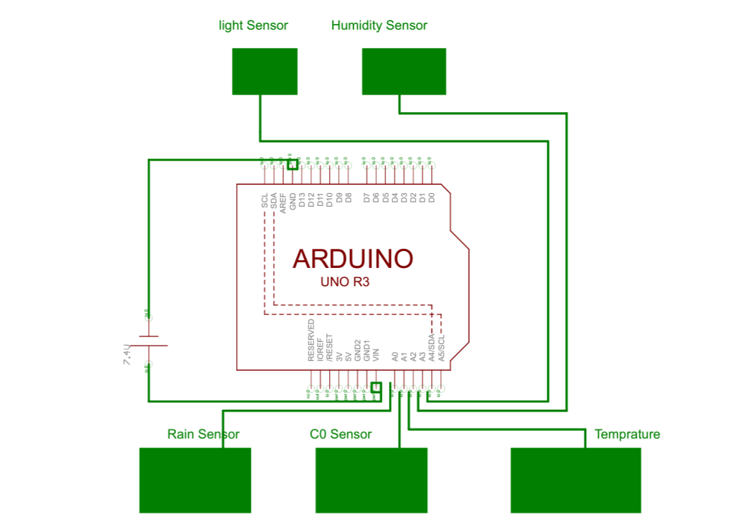
Circuit Diagram
SmartT (Smart Cities, Smart Sensors)
Notes:
Block diagram of the Hardware

Slide 7
Features of the project
Sensors
  Converts data receive in the nature into electrical signals to be processed by the Microprocessor
Arduino and GSM Module
  Process signals receive by the sensors as data and make them intelligible and transmit them to the wen server via a GSM Module
Web and Mobile applications
  Written in Couchdb
  Initial load of page, shows Google Map, overlay with Google Traffic image, overlay with the geo-location of the sensors
  Icon changes to some boundary conditions, hot, cold, rain, power off
  Clicking on the icon of the sensor, shows the latest data sent from it
SmartT (Smart Cities, Smart Sensors)
http://en.wikipedia.org/wiki/Image:K2-w_vaccuum_tube_op-amp.jpg1

Slide 8
Project constraints
Minimize the cost of the end product
  Use low cost sensors available
Embedded all the parts
  Arduino in our case is the Low cost microcontroller with almost all the features need to be used as development Board
  GSM Module communicate well with Arduino and the web server
Integration of proto
  Code written in Couchdb to communicate with Google map
SmartT (Smart Cities, Smart Sensors)

Slide 9
Summary
Hardware Build (sensors and signal conditioning and scaling)
  Software (Arduino code in C and web and Mobile application in Written in Couchdb)
Embedded systems (stand alone systems)
Telecommunications (GSM for data transmissions between Arduino and web server)
SmartT (Smart Cities, Smart Sensors)

Slide 10

Team members
SmartT (Smart Cities, Smart Sensors)

Slide 11
QUESTIONS ?
SmartT (Smart Cities, Smart Sensors)

